Slide 2
What is Online Shopping?
The online selling of or enabling
the sale of products or services
to consumers.

Slide 3
How did Online Shopping come about?
Online shopping emerged with the development of the internet.
Entrepreneurs saw the potential in online shopping and sprung at the chance to make virtual storefronts, so that consumers could shop without leaving their homes.

Slide 4
Project description…..

Slide 5
On line shopping provide realibility to shop any product.
In today’s busy life it provide relief to individual to save their time.
Because of satisfaction of the service it demands more.

Slide 6
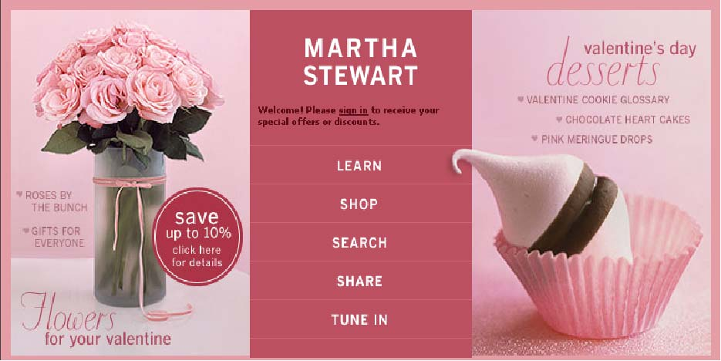
Merchandising :

Slide 7
Merchandising:
Is the art and science of how the products, features, and services are displayed, advertised, and promoted.
Helps create the experience you want your customers to have.

Slide 8
Goals:
-Best Selling
-Best Customer service
-Save the important time of customer
-Satisfaction of customer
-Ease of access our service
-Much and Best outcome of applicaton

Slide 9
Will Provide….
Login form
Price Quote
Information about product
Brand of Product
Order History

Slide 10
Expected outcomes:
Less dependence on intermediaries
-Geographic distribution
-Time to delivery
Marketing
-Target marketing
-Direct customer relationships
-Customer service

Slide 11
Tools AND TECHNOLOGY FOR On-line Shopping
Tools:
AjaxToolkit
ADO.net
Validation Fields
CSS
HTML

Slide 12
Technology:
Asp.net in c#
Front-End: Microsoft Visual Studio2010
Back-End: Microsoft SQL Server2008

Slide 13
Thank you…….

